Slide 1
BRITISH AIRWAYS
CUSTOMER RATING ANALYSIS AND INSIGHTS
DATE:06-03-2023

Slide 2
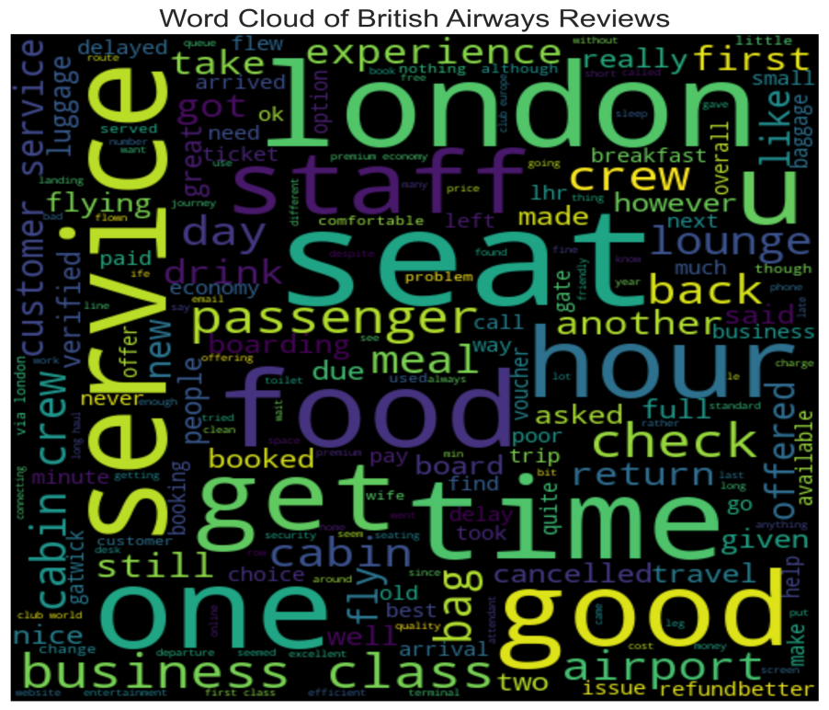
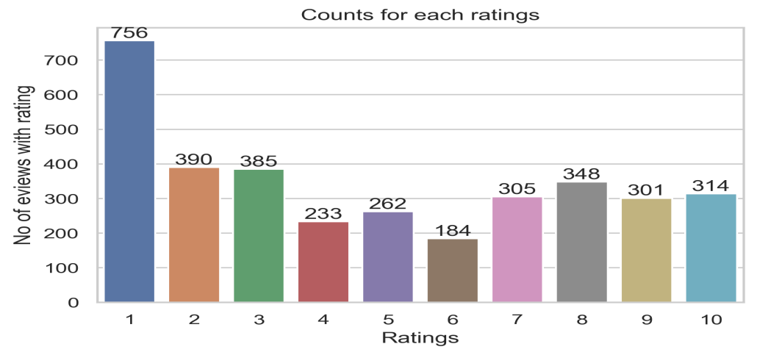
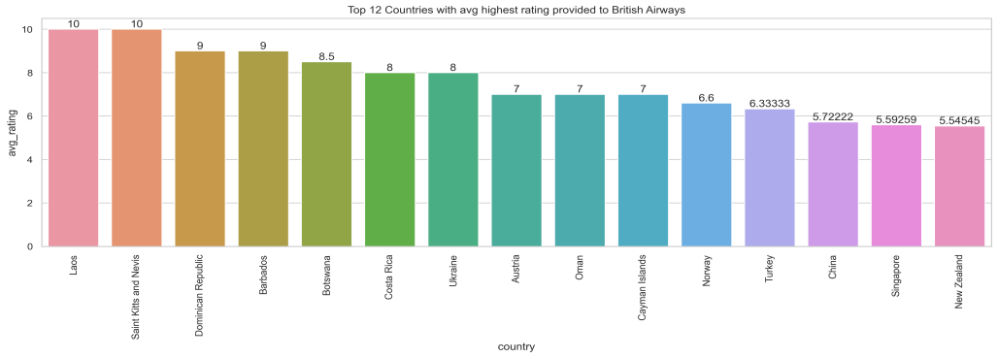
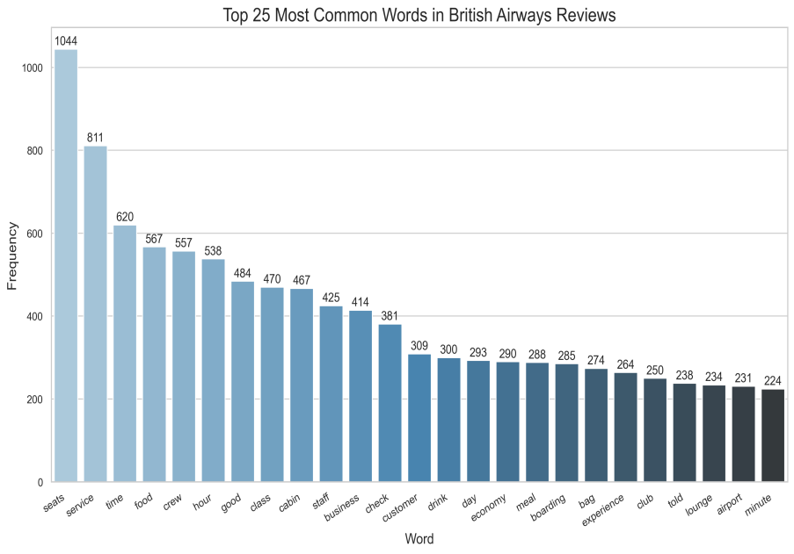
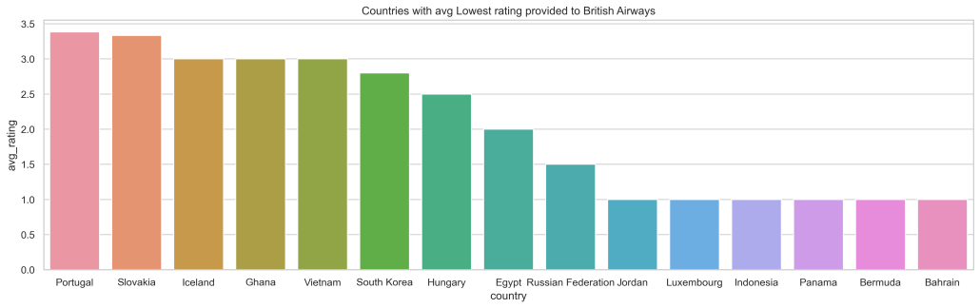
FINDINGS
AVERAGE OVERALL RATING: 4.83/10
TOTAL REVIEWS COLLECTED: 3485
REVIEWS FROM 69 COUNTRIES
Count for each rating:
There are 756 customers with 1 star rating and 314 customer with 10 start rating.
Average highest rating provided to British Airways is from Laos and Saint Kitts and Nevis.
Average lowest rating provided to British Airwaws is from Jordan, Luxembourg, Indonesia, Panama, Bermuda, Bahrain.
What customers are pleased and dissatisfied with for rating class:
Rating1-3: They are dissatisfied with the global pandamic reaction. They are pleased with the food, drinks, seating, and staff.
Rating4-7: They faced problems with bad business call experience and they are satisfied with the services.
Rating8-10:They are satisfied with the business call seats, cabin crew, food, drinks and services.

